Slide 1




Exponentially Greater
Family Math Night Engagement
© 2021 Great Minds PBC
Notes:
Welcome families to our Eureka Math Squared Math Night.

Slide 2
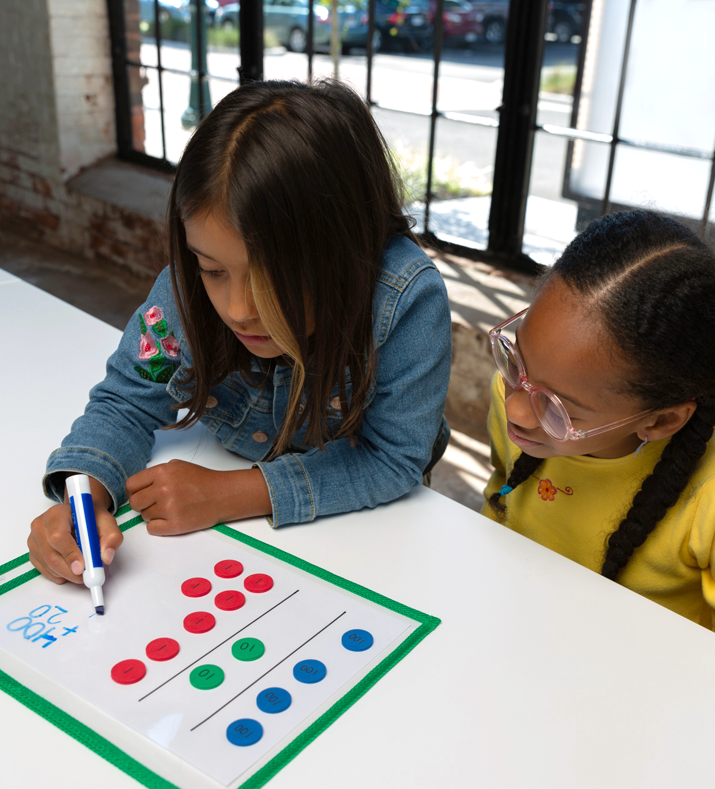

Knowledge Building
The Why Behind the Math
Problems develop from simple to complex
Hands-on and pictorial models
Practice opportunities
How mathematicians think
Joyful Math Experiences
Real life connections
Interactive learning
Talking about math
Collaboration with peers
© 2022 Great Minds PBC
Notes:
K-5
Lessons were designed to develop understanding of mathematics. Hands-on learning and problem progressions support students in knowing the why behind the math and flexibility of thinking.
Students have many opportunities to practice newly learned concepts. Students learn to think like mathematicians with real life contexts.
In a Eureka Math classroom, you will find students working together and talking about their mathematical ideas.

Slide 3
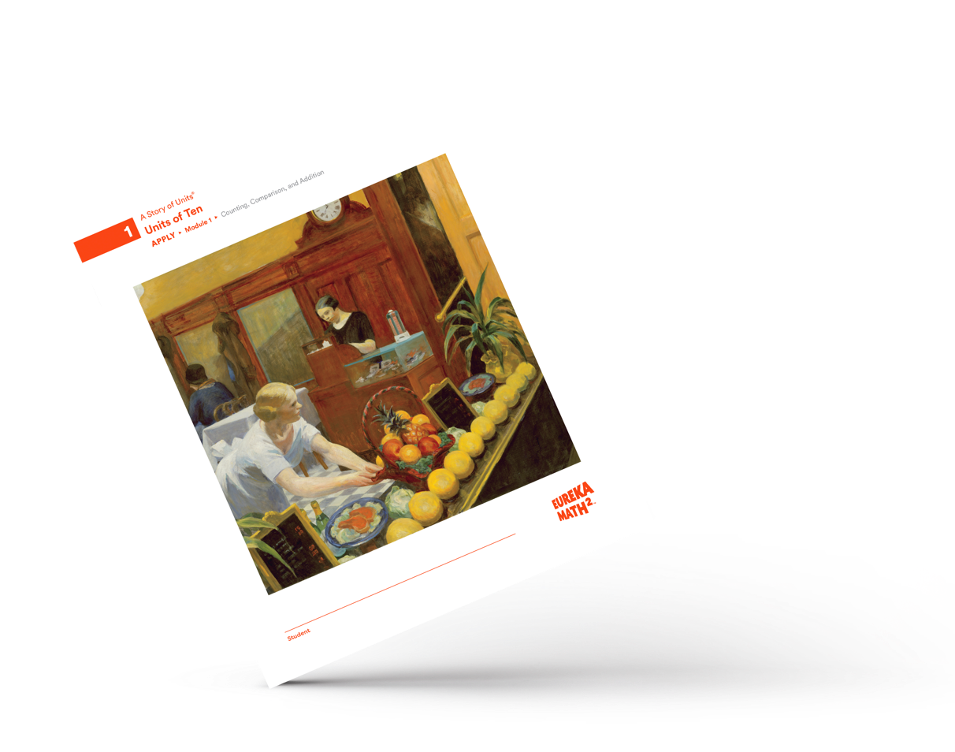

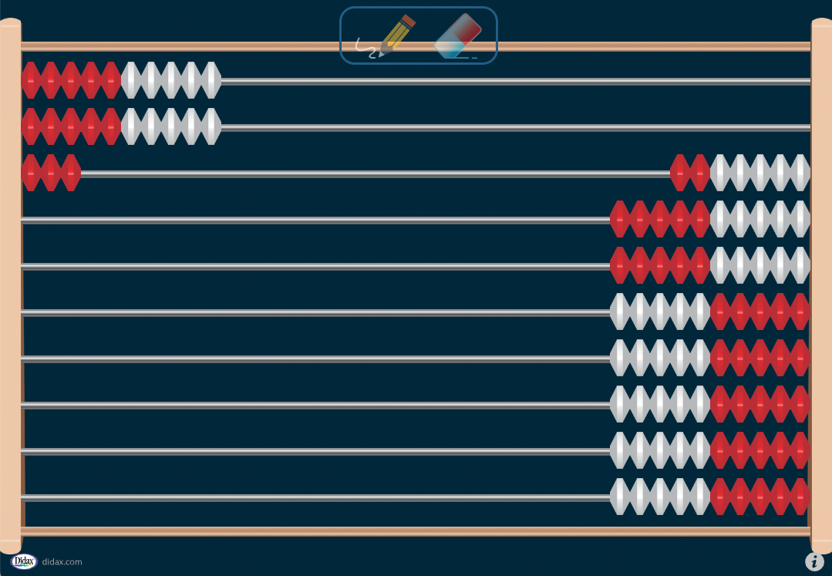
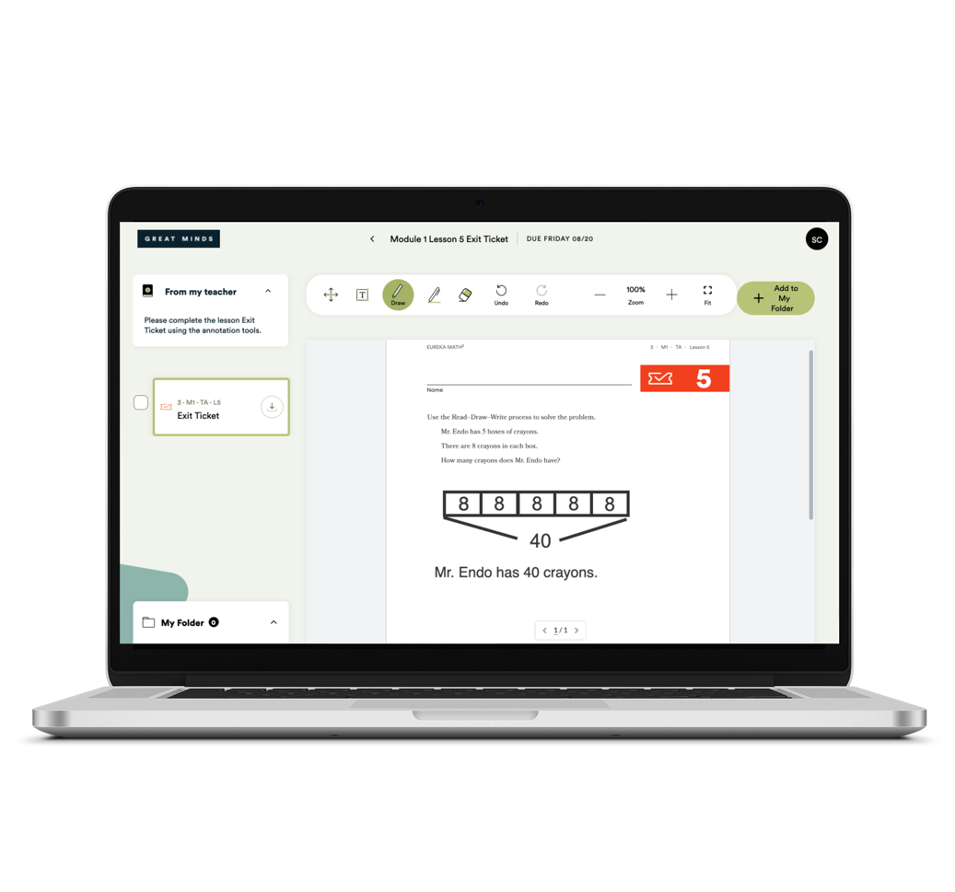
Student Materials l K–5
Learn & Apply books
Didax™ manipulatives
Great Minds® Digital Platform
Notes:
K-5
We have a comprehensive, knowledge-building curriculum. Eureka Math² engages students in mathematics with print materials, digital interactives and lessons, and manipulatives for hands on learning.
The Learn book has all the print resources a student needs to be successful when learning grade-level concepts in class. And Apply is designed for use at home.
And our Great Minds digital platform includes context videos, dynamic teacher led interactives, and student facing assignments and assessments.

Slide 4
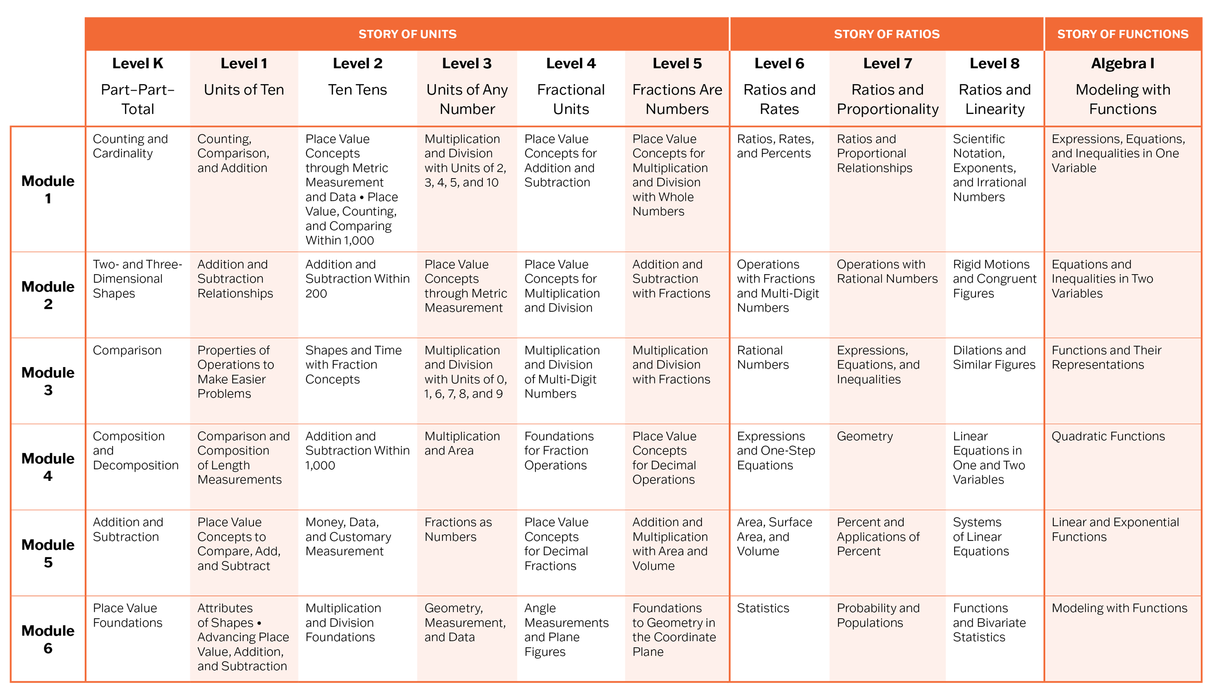
Mathematics as a Story …
Notes:
K-9 CHOICE SLIDE
Something important for you to know about Eureka Math² is that it’s designed as a coherent story that makes sense. The teacher writers and mathematicians thought strategically about how the mathematics would unfold from PreK all the way to Grade 12.
The concepts, language, and models might develop over time, so through the curriculum, students would experience mathematics as a discipline of logically connected ideas. This helps students draw on what they know and apply it to new learning.

Slide 5
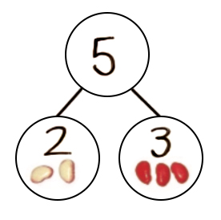
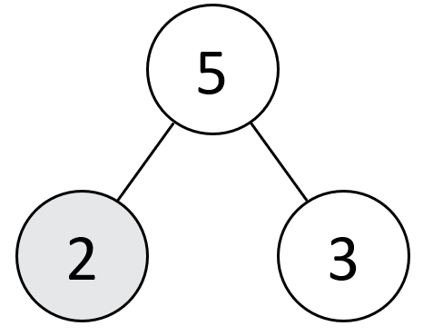
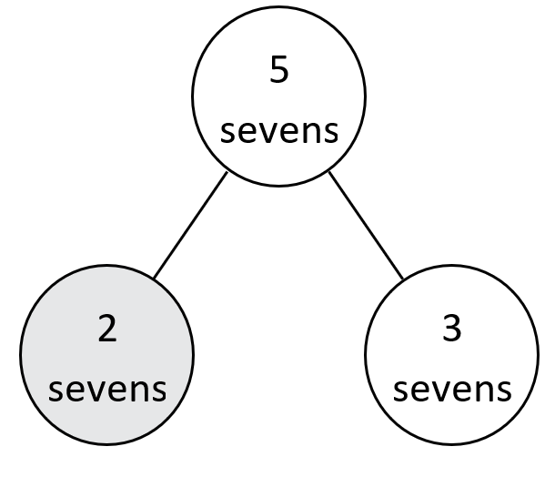
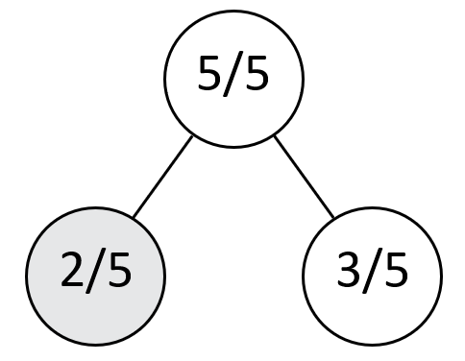
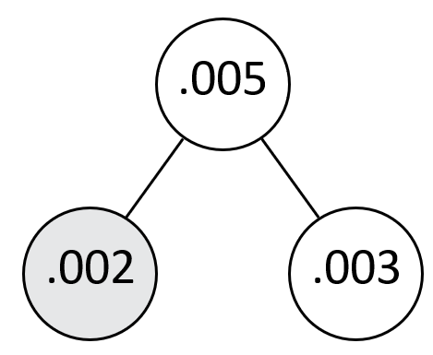
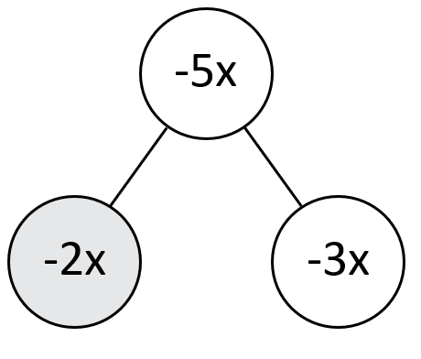



A Story of Units
$$\frac{5}{5}$$
$$\frac{2}{5}$$
$$\frac{3}{5}$$
Number Bonds
Notes:
K-9
The intentional coherence in the curriculum takes on many forms, but it is perhaps best exemplified by the consistent set of powerful visual models used year after year. Our coherence of high leverage models across grade levels means that as we introduce new topics, students are grounded and secure, seeing each new topic as an extension of something they already knew, made visible by the models.
Consider how the number bond model is an example of a high-leverage model that is used coherently throughout the curriculum to help students understand critical part-whole relationships.
In Kindergarten, students use the number bond to understand part-part-total relationships and represent math stories. 2 and 3 make 5, 3 and 2 make 5.
(CLICK) Then they consider the part-whole-relationships represented by number bonds to find an unknown in a word problem or equation. For example to solve 5- 3, they may think, “ I know 2 and 3 make 5, so the missing part is 2.”
(CLICK) Students may use a number bond to represent equal groups that make a total or to highlight the distributive property as shown here. You can see that 5 x 7 can be decomposed into 2 x 7 and 3 x 7.
(CLICK) Numbers bonds are also helpful to compose and decompose fractions and (CLICK) decimals, (CLICK) integers, and even variables.

Slide 6
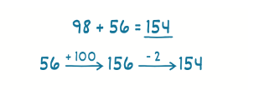
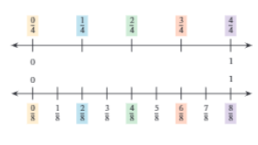
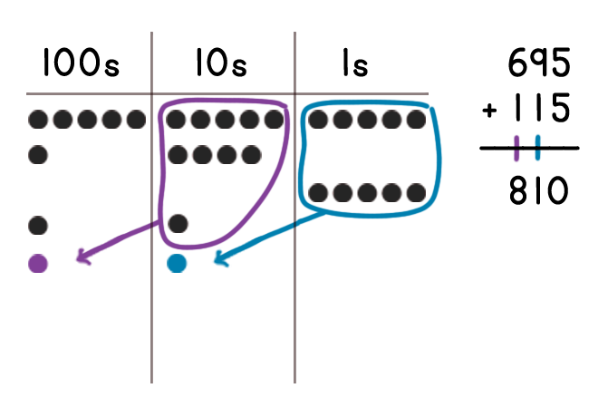
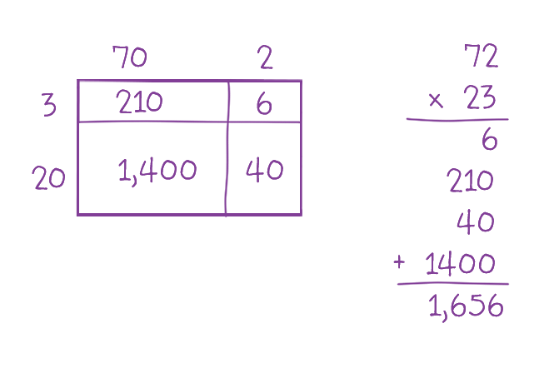

Pictorial Models
Place Value Chart
Arrow Way
Number Lines
Area Model
Tape Diagrams
Notes:
Consistent use of high leverage models such as number bonds, area models, tape diagrams and number lines move with students within and across grade levels. These models supports students to deeply understand the WHY behind the math even as the units and calculations become more complex.

Slide 7
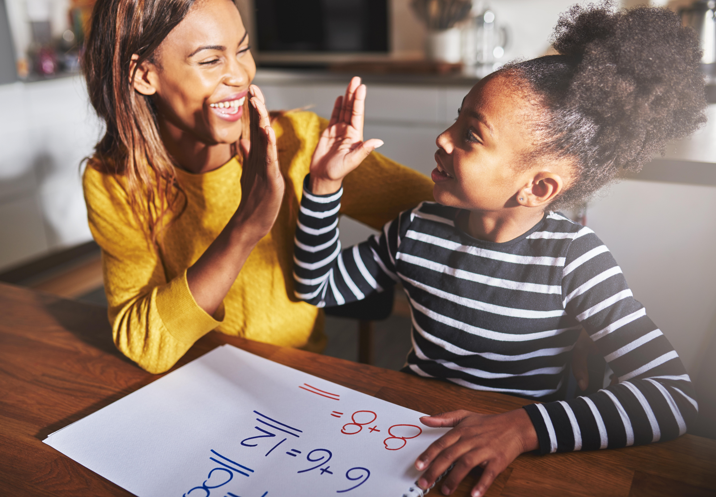




Partnership Matters
Notes:
We honor you as you are your child's first teacher.
Is it ok if you have questions, reach out for support. Any time you spend time with your child on mathematics is helpful and valuable.
Together we can help your students achieve greatness.

Slide 8

Math is for Everybody
“Instead of saying I am not good at math, say I have not learned it yet.”
Math Affirmations
You are a math person
There is more than one strategy
Math is useful in our lives
It is important to try and not give up
Mathematicians make mistakes
We learn from our mistakes
The process is more important than the product
Notes:
Note to presenting teacher: Summarize growth mindset as seen within the curriculum and in your classroom. Use the bullets as a guide.

Slide 9
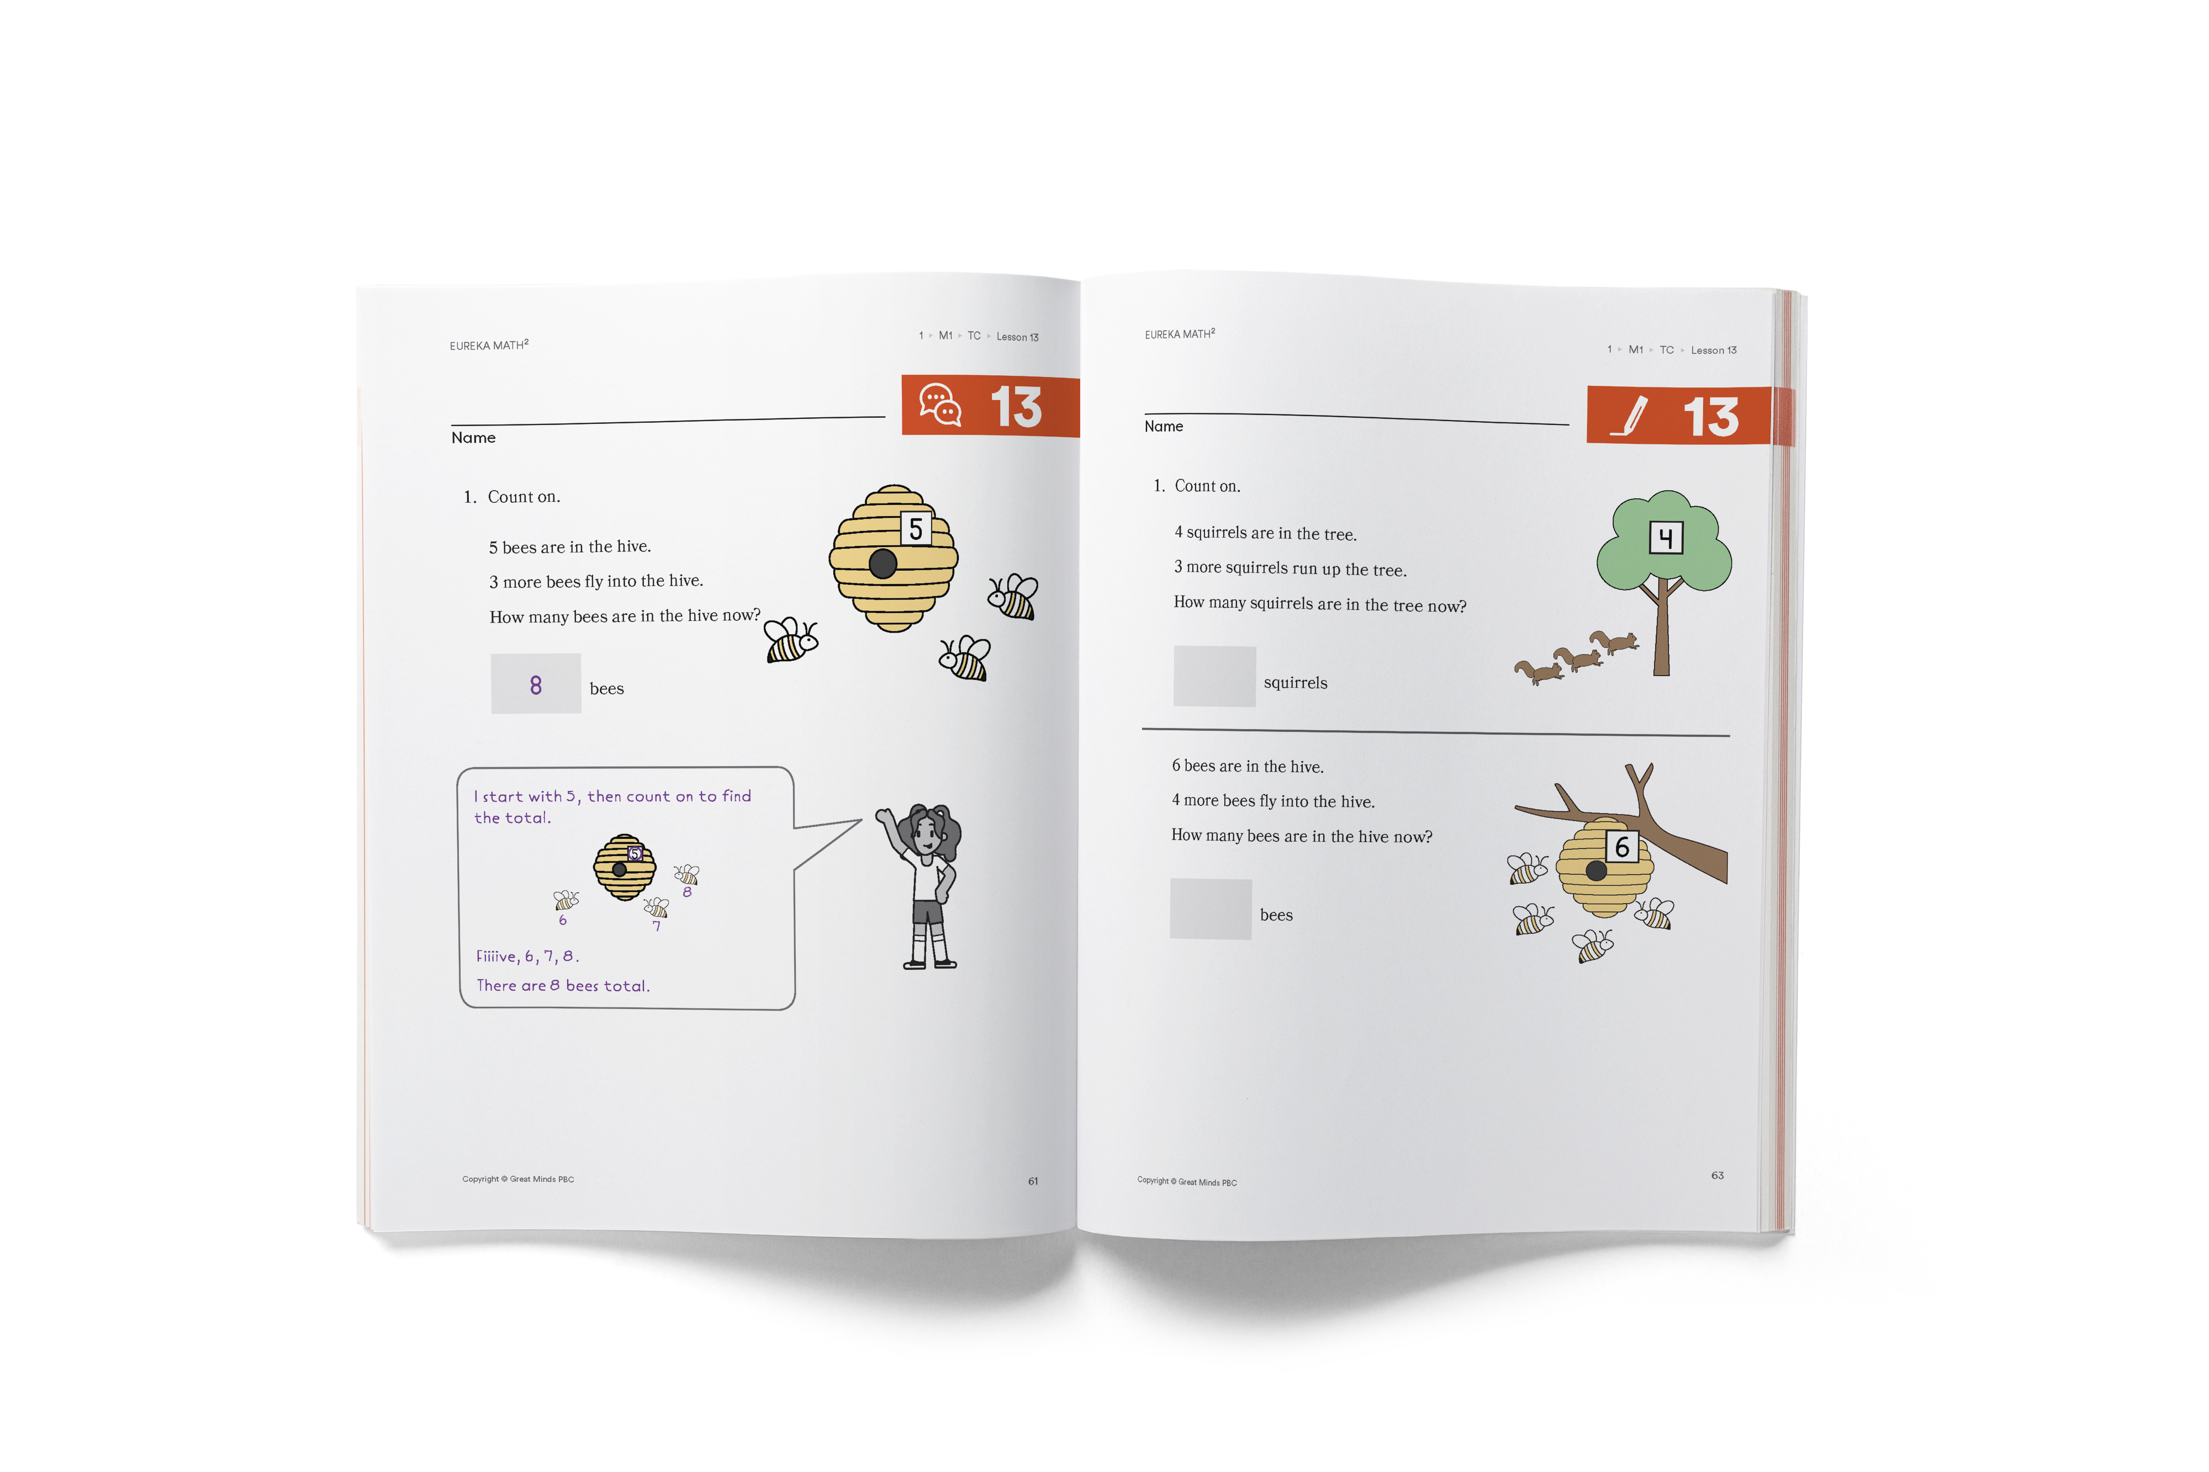
How to Help
Practice Support
Use the thinking of the “partner” who is solving problems like those in the Practice.
Ask Questions
What do you notice about how they solve the problem?
How have you solved a problem like this before?
How can you start the problem?
What tool can you use?
Notes:
Students may develop and practice concepts at home using the practice and remember problems in their Apply book. The practice problems are similar to the problems seen in that day's lesson. The remember problems were seen in previous lessons.
Practice partners will guide a student and care giver through possible solution pathways using similar problems.

Slide 10
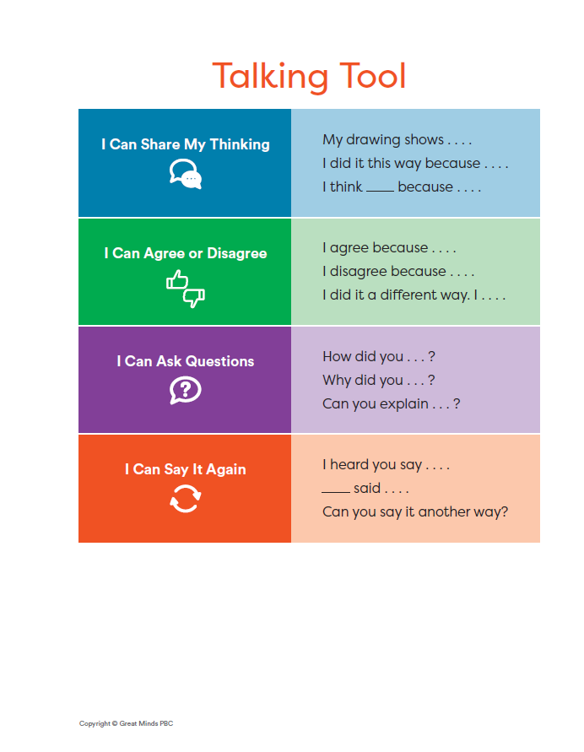
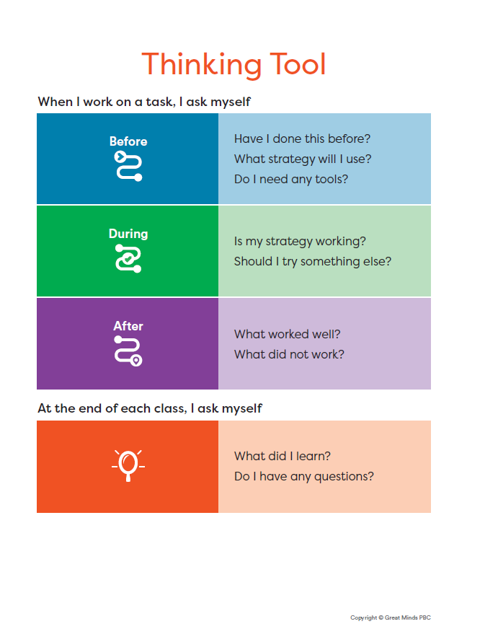
Talking and Thinking Tools
Notes:
Note to presenting teacher- If providing copies of these tools to parents, consider explaining how they can be used at home:
The talking tool provides sentence and question stems that encourage students to use conversation to explain their own thinking and respond to other's thinking.
The thinking tool provides a framework to assist students with solving problems.

Slide 11
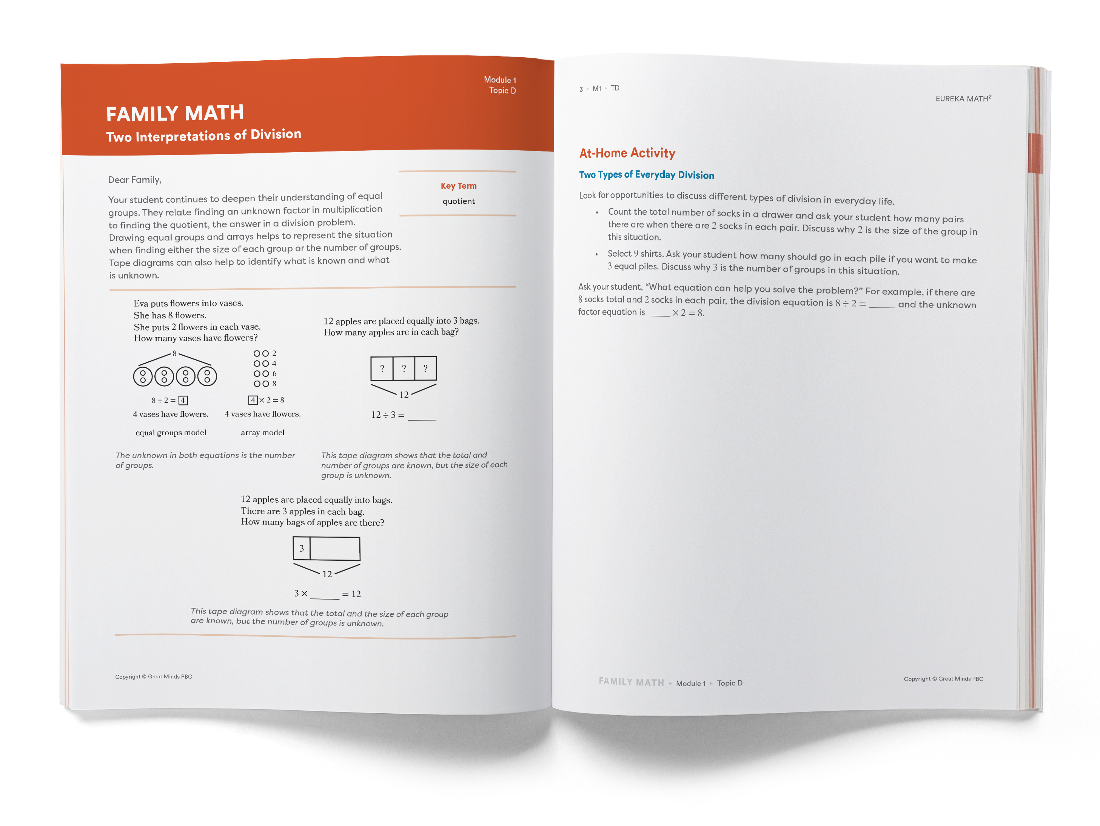
Family Math
Describes and shows key math concepts
Highlights new math vocabulary
Provides activities for student and family to do together at home
Notes:
Family math is a letter that describes the major concepts, models, and terminology in each topic.
Consider trying one or more activities from the family math letter. Family math letters may come home about every 5-10 days.

Slide 12
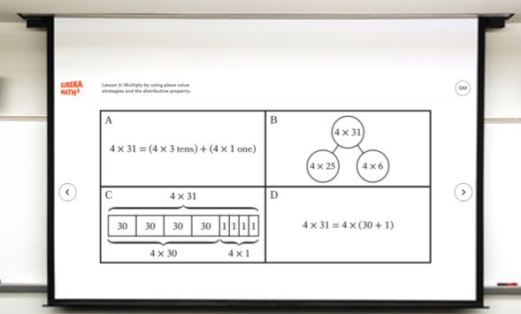
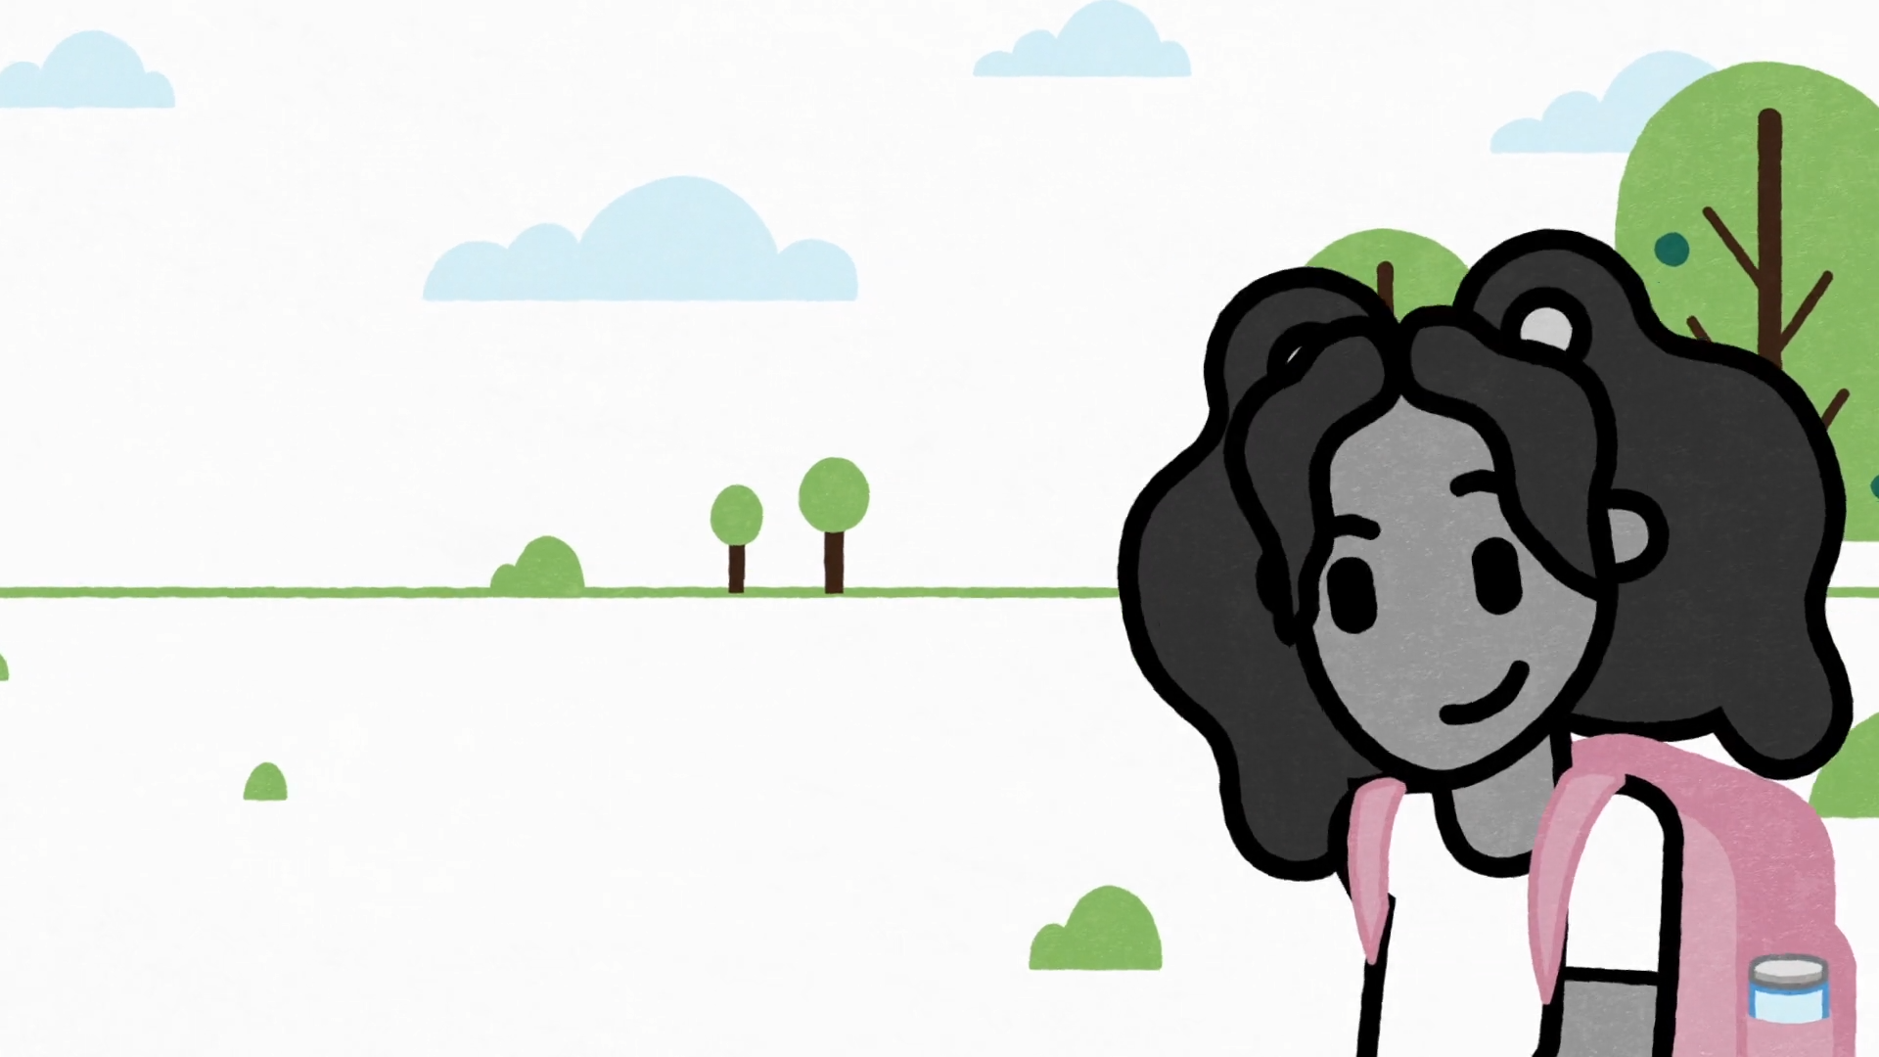
Encouraging Math at Home
Notice and wonder
Play games
Cook and build
Sort and count
Ask how many?
Solve it another way…
Notes:
In some lessons we have math context videos that can connect what the students are learning to a real-world experience they may relate to. Let’s engage in this lesson’s context video with the notice and wonder routine. As I play the video – take note of what you notice and wonder. (PLAY VIDEO)
After playing the video the teacher would then ask students to share what they noticed, and what they wondered. Take a moment now to share what you noticed and wondered. <RECORD 2-3 RESPONSES>
It’s important to note here that there are no wrong answers when engaging with the notice and wonder routine…we’re giving all students an opportunity to engage in the lesson. There are many mathematical questions that students can ask, but the focus question in this lesson is on determining the the total number of rocks so the teacher will naturally facilitate a conversation with students to go in that direction.
The videos help students visualize how math is part of their real world. The characters represent diverse backgrounds and provide students an opportunity to see themselves in the content. You’ll also notice that the video doesn’t require any previous background knowledge. All students can engage, and the wordless format removes any language or reading barriers that could limit participation. Every student is invited in to tell the story of the math problem, to notice, to wonder, and drive the discussion.
video url (internal) https://greatminds.wistia.com/medias/3m7cmpospt

Slide 13
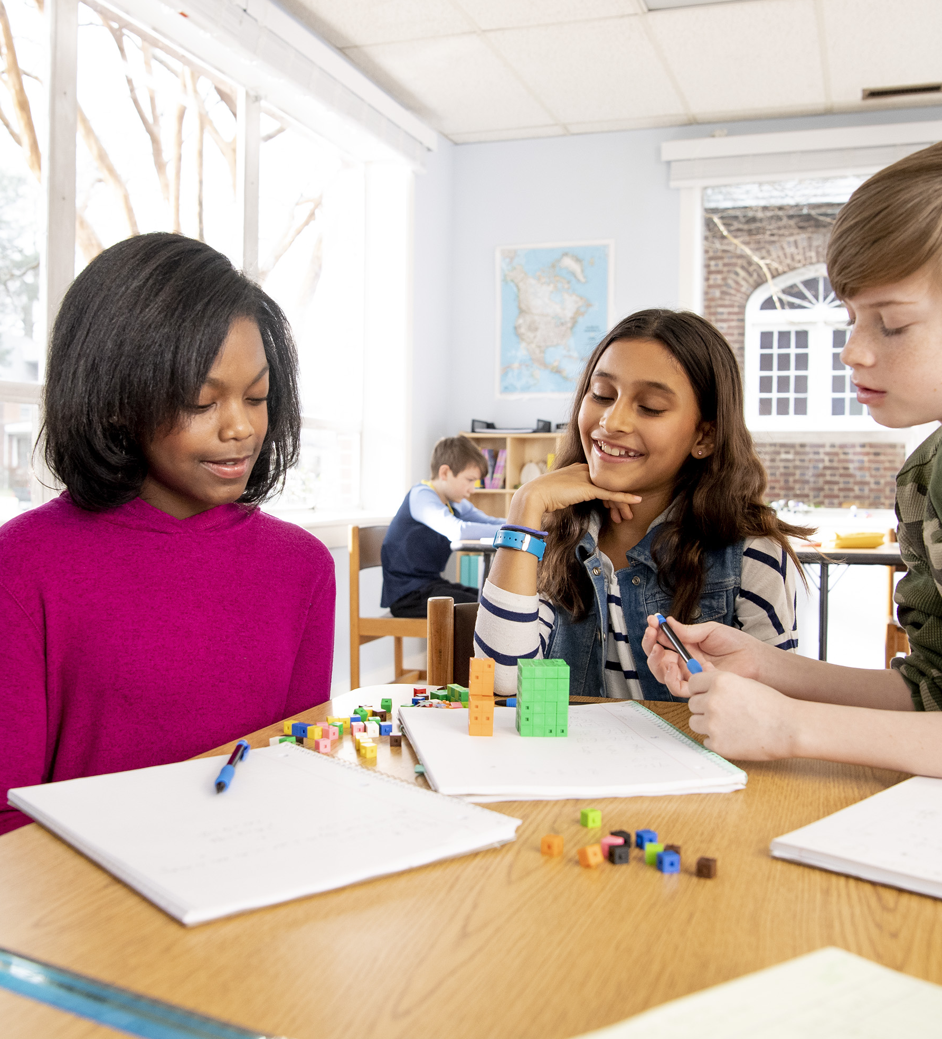

Q & A
Be sure to visit our family
math page.
https://greatminds.org/eureka-math-squared-family-resources
Notes:
Presenting teacher note: Consider showing the family math page and highlighting resources the parents can access.

